Slide 1
FOSS PROJECT DEMO
Conversational AI Signboard Translator with Rasa

Slide 2
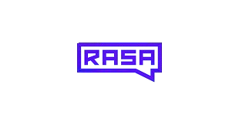
INTRODUCTION OF TOOL - RASA
Rasa - Open-source conversational AI framework.
Provides tools for Natural Language Understanding (NLU) and Dialogue Management.
Used widely for building AI-powered apps that understand multi-language queries.
Builds chatbots & virtual assistants.
In this project, Rasa acts as the core AI assistant for translation and user interaction.

Slide 3
LICENSES OF THE TOOL
Rasa Open Source is released under the Apache 2.0 License.
This license allows:
- Free usage, modification, and distribution.
- Commercial and academic use.
- Contribution to community development.
- Encourages open collaboration and innovation.

Slide 4
ALTERNATIVES FOR THE TOOL
Dialogflow (Google) – Cloud-based NLP platform for chatbots.
Microsoft Bot Framework – Enterprise-grade conversational AI.
IBM Watson Assistant – AI service for virtual agents.
Botpress – Open-source chatbot framework.
Amazon Lex – AWS conversational AI service.

Slide 5
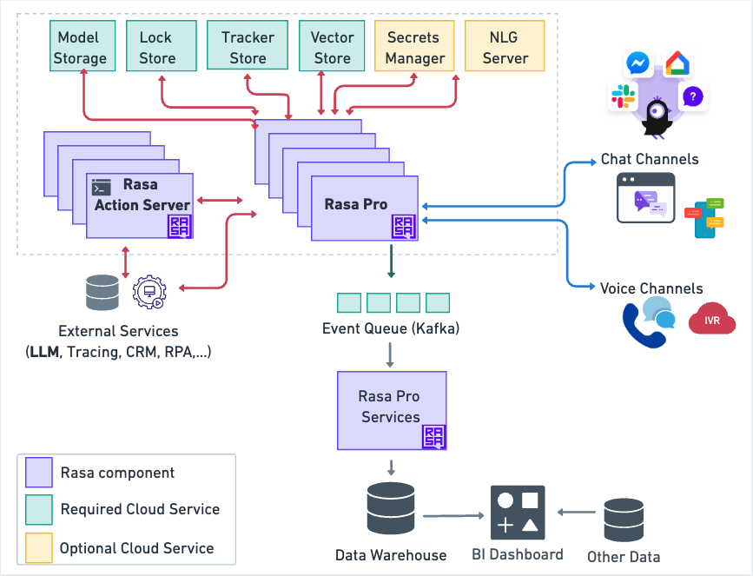
ADVANTAGES OF USING THE TOOL
Open Source & Free
Context-Aware Conversations
Customizable
Supports Multiple Languages
Active Community Support
Full data privacy & control
RASA ARCHITECTURE

Slide 6
Installation Steps(In linux)
Update packages:
Install Python & pip:
Create virtual environment:

Slide 7
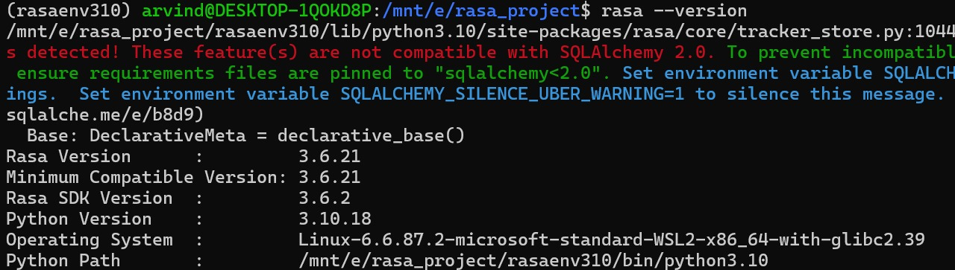
Installation Steps(In linux)
4. Install Rasa:
5. Verify installation:

Slide 8
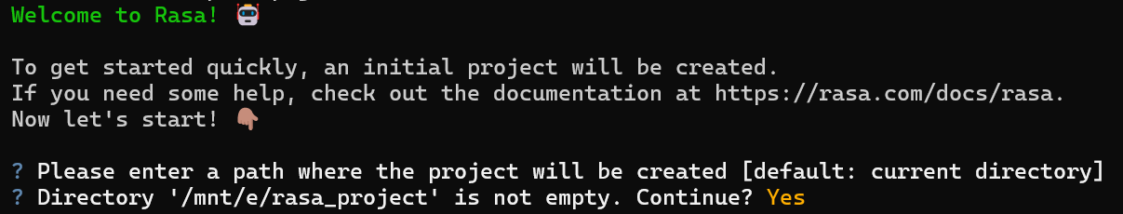
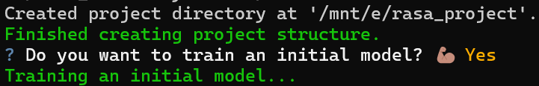
Screenshot of our work (Module wise)
1.Initializing rasa

Slide 9
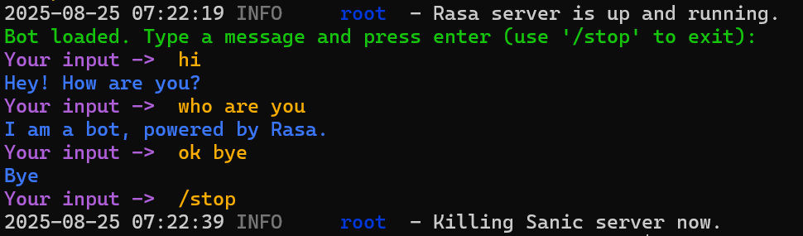
Initially trained automatically

Slide 10
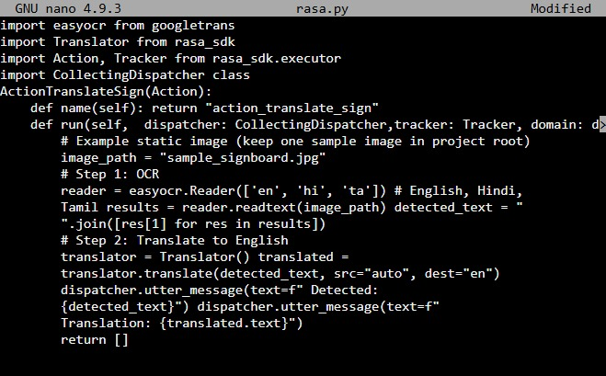
Actions.py
easyocr- to recognize the characters from image
Translator will translate the characters detected from easyocr.

Slide 11
